Slide 1
Screening & Intervening
March 2018

Slide 2
Children are wired for sound, but print is an optional accessory that must be painstakingly bolted on.
~Steven Pinker

Slide 3
Dyslexia is..
• a specific learning disability
• neurobiological in origin
• characterized by difficulties with accurate and/or fluent word recognition and by poor spelling and decoding abilities
• difficulties typically result from a deficit in the phonological component of language
• difficulties often unexpected in relation to other cognitive abilities and the provision of effective classroom instruction
• secondary consequences may include problems in reading comprehension and reduced reading experience that can impede growth of vocabulary and background knowledge.
IDA/NICHD, 2002

Slide 4
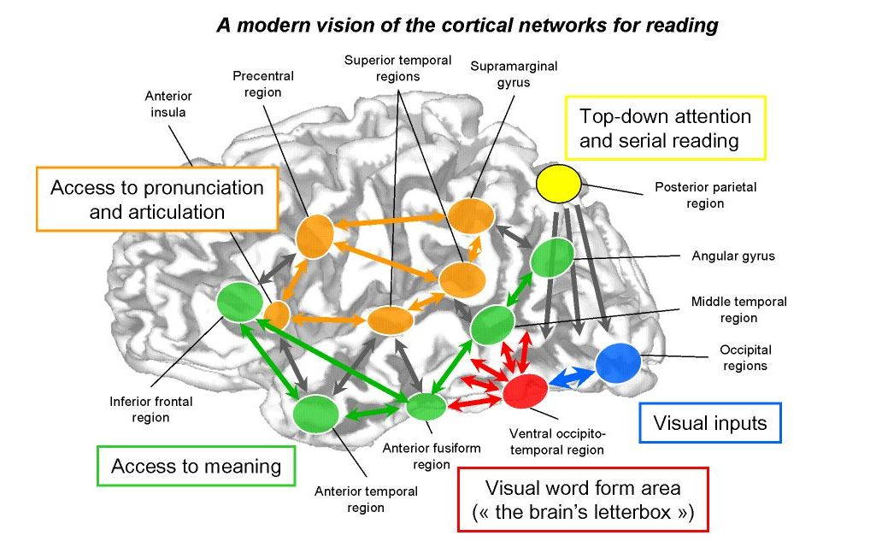
Source: http://quantum-mind.co.uk/dehaene-on-reading-in-the-brain/

Slide 5
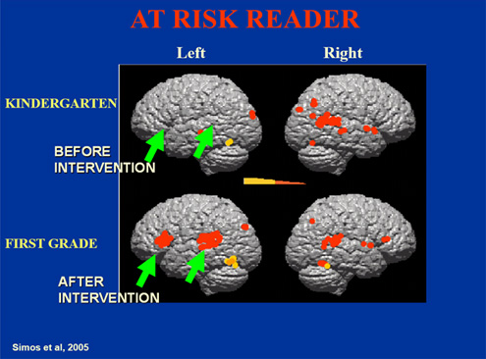
Pre and Post Intervention

Slide 6
Elementary Characteristics
Delayed speech
Mixing up sounds and syllables
Confusion over directionally based words
Late establishing a dominant hand
Difficulty learning a sequence
Trouble with the concept of rhyming
Poor Spelling

Slide 7
Difficulty learning a new word even after multiple teachings
Word Retrieval
Trouble memorizing
Doesn’t associate letters with sounds
Doesn’t understand words “come apart”

Slide 8
Reading Aloud
Guesses based on shape (house/horse, breakfast/basket)
Correct sounds, incorrect sequence (from/form, stop/spot, was/saw, who/how, lots/lost) may use semantic substitution (speed/fast, puppy/dog)
Inserts or omits sounds (could/cold, stream/steam,
Skips or misreads prepositions
Ignores suffixes (even/evening, come/coming)
Confuses vowel sounds (bat/bet/bit)
Letter and number reversals beyond second grade

Slide 9
One in Five
Dyslexia and all its inherent characteristics exist on a spectrum.
No two students will look exactly alike.

Slide 10
Related Strengths
Problem-solving
Sees the “big picture”
“Out-of-the-box” thinker
Strong verbal, people skills
Creative, artistic, musical
Visual-spatial strengths
Often gifted in math, technical skills, mechanical or computing
(source; webmd.com)

Slide 11
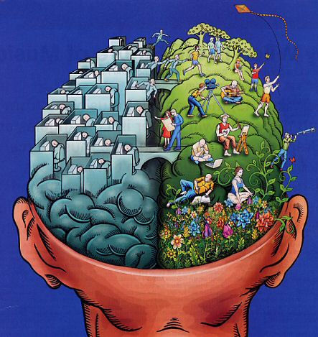
http://creationwiki.org/Dyslexia

Slide 12
Every child would read if it were in his power to do so.
~Betts,1936

Slide 13
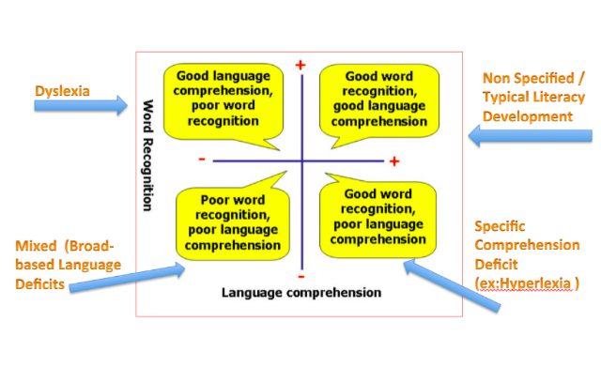
Simple View of Reading Decoding x Language Comprehension = Reading Comprehension (Hoover & Gough, 1990)
https://www.tes.com/lessons/NOH6EB5iqEyVzQ/theoretical-models-of-reading-comprehension

Slide 14
Reading Readiness
Phonemic Awareness is the CORE and CAUSAL factor that separates normal readers from disabled readers.”
-G. Reid Lyon

Slide 15
Screening

Slide 16
Who should be screened?
each student kindergarten through grade 3 each year.
Grades 1-3 should be screened within the first 30 days of the school year, with follow up at the middle and end of the year for systematic documentation of progress or lack of progress.
Kindergarten initial screening should occur no later than January 31st and also at the end of the year for systematic documentation and progress monitoring.
any student K-3 who transfers from a school within the state that has not previously been screened.
any student K-3 who transfers from another state and cannot present documentation that the student has a previous screening.
a student in grades 4 or higher who is experiencing consistent difficulty in the areas of weakness noted previously in this report as determined by the classroom teacher or as requested by the student’s parent/guardian.

Slide 17
Exemptions
Existing diagnosis of dyslexia
Students with a sensory impairment (visual/auditory)
Severe intellectual disabilities
English Learner’s where tools or staffing related to administration and/or interpretation in native language is unavailable

Slide 18
Screening is not..
A diagnosis
Automatic eligibility
An automatic referral for eligibility
Justification for a 504

Slide 19
Components
Phonological awareness (words, syllables, rhyming, onset-rime, blending, and syllable and word segmentation)
Sound/symbol recognition
Alphabet knowledge (letter naming fluency)
Phonological memory (non-word repetition)
Rapid automatic naming
Alphabet knowledge
Decoding (real and nonsense words)

Slide 20
When a student can read simple nonsense word patterns, this is an important indicator that she is starting to internalize her decoding skills.
R. Selznick

Slide 21
Considerations
What assessments/measures currently in use?
Reliable
Valid
Criterion-referenced
Formal and informal
Does the tool align with the guidance?
Is that data detailed enough?
Small group instruction
Who is collecting/sharing the data?
Implications for Tier 1 instruction?

Slide 22
Data Collection

Slide 23
Phonological awareness
Underlying cause of decoding difficulties
Develops on a continuum
Large skills to small
Advanced PA skills
How much is enough?
Must be explicitly and systematically addressed
Intentional not incidental
Continues beyond 3rd grade

Slide 25
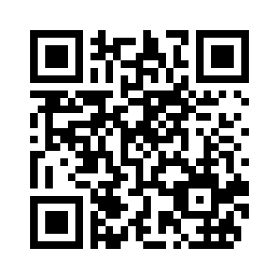
Please provide us feedback..
https://www.surveymonkey.com/r/OCCREvaluation

Slide 26
Thank you!
Kim Stuckey
573-751-2584
kim.stuckey@dese.mo.gov
Edmodo Group Code: fsj36g

Slide 27
Resources
Bowers, Peter, How the Written Word Works, 2010
Henry, Marcia, Unlocking Literacy, 2nd Ed., 2010
Kilpatrick, David, Equipped for Reading Success, 2016
Kilpatrick, David, Essentials of Assessing, Preventing and Overcoming Reading Difficulties, 2015
Selznick, Richard, Dyslexia Screening, 2015

Slide 28
References
Begintoread.com; http://www.begintoread.com/research/ literacystatistics.html
Ehri, Linnea; Development of Sight Word Reading: Phases and Findings, The Science of Reading, A Handbook, Chapter 8, Blackwell Publishing, 2005.
Dehaene, Stanislas, Reading in the Brain, 2010.
www.dys-add.com, Bright Solutions for Dyslexia
Gaab, Nadine, thegaablab.com/publications.html
Henry, Marcia, Unlocking Literacy, 2nd Ed. 2010
International Dyslexia Association www.eida.org
Kilpatrick, David, Equipped for Reading Success, 2016
Kilpatrick, David, Essentials of Assessing, Preventing and Overcoming Reading Difficulties, 2015

Slide 29
References
Lyon, Reid, International Dyslexia Association Keynote, 2009
Moats, Louisa, Reading is Rocket Science, 1999
National Center for Learning Disabilities, www.ncld.org
Pegado, Felipe,; Nakamura, Kimihiro,; Hannagan, Thomas, How does literacy break mirror invariance in the visual system, Frontiers in Psychology, July 2014
Shaywitz, Sally; Overcoming Dyslexia, 2003
Selznick, Richard; Dyslexia Screening, 2015
Torgesen, Joseph K, Avoiding the Devastating Downward Sprial, www.aft.org/periodical/american-educator/fall-2004/avoiding-devasting-downward-sprial

