Slide 1
Creating, formatting, and editing graphs using Google Sheets
It is best to view this a slide show to navigate to different slides. To view as a slide show, choose “View” then “Present” or “Ctrl+F5” on your keyboard.
Updated 4/6/16

Slide 2
Contents - click a link to skip to that slide/section
Spreadsheet terminology
Creating a graph (slides 4 and 5)
Inserting a trendline
*How to…
...move the graph to its own sheet/tab
...make the cells change color when a certain criteria is attained (conditional formatting)
...change the color of data lines on the graph
...display individual data points with shapes (or remove the shapes)
...change the shapes and sizes of data points
...add values to each data point
...edit the title of the graph
...edit the graph’s axis labels
...edit the left vertical axis range
...edit the graph’s legend
...expand the number of cells that are included in the graph
...troubleshooting
*Most of these features can be edited via the “Advanced Edit” menu under “Customization” as well.

Slide 3
Spreadsheet Terminology
Rows are numbered - in the picture below, Row 1 is highlighted
Columns are lettered - in the picture below, you can see Columns A through G
Cells correspond to a letter and number - in the picture below, Cell A1 is selected
Back to contents slide

Slide 4
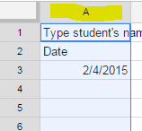
Creating a Graph - Format and Enter Data
Type the student’s name in Row 1
Label Column A by typing “Date” in Cell A2
Label Columns B and C by typing in the target skills
You can format Column A for a certain date format
Select Column A by clicking on the gray box with A in it (see picture)
Format → Numbers → Date (or More Formats to explore options)
You can format Columns B and C to be a percent or whole number
Select Column B (or Column C)
Format → Numbers → … (may have to choose “More Formats” then “Custom Number Format” to explore and choose the desired format)
Enter data
Dates in Column A
Corresponding goal data in Columns B and C
Back to contents slide

Slide 5
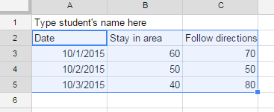
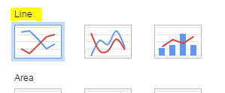
Creating a Graph - Select Data and Insert Graph
Highlight the data you want to graph - include the heading cells (“Date” and the descriptions of targeted skills)
Click Insert→ Chart
The Chart box will pop up
Click Chart Types
Select the first type of line graph
Click Insert or Customization (after Customizing, must click Insert)
Back to contents slide

Slide 6
Inserting a trendline on the graph
Inserting a trendline after the graph has been created
Click on the data line and choose the trendline icon
From the trendline dropdown choose “Linear”
Do this for each data line on the graph
Inserting a trendline from the Customization tab on the Chart pop up box
Scroll down and choose “Linear” from the Trendline dropdown
*A column of dates MUST be included
in the data selection, otherwise
“Trendline” will not be an option
Back to contents slide

Slide 7
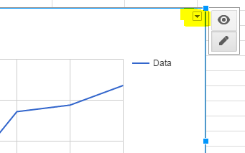
How to move the graph to its own sheet/tab
Click on the graph so that a triangle/down arrow appear in the upper right corner of that box containing the graph.
Click on the arrow and choose “Move to own sheet…”
Your graph will now be on a separate tab labeled “Chart 1”
Back to contents slide

Slide 8
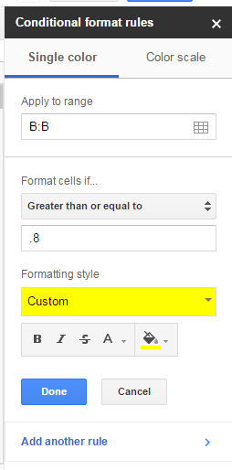
How to make cells change color when a certain criteria is attained
In the data entry spreadsheet, cells can be programmed to change color (background or text) when a defined criteria/condition is met
Select/highlight the cells or entire columns you want to format
Select Format → Conditional formatting…
A conditional formatting menu will pop up on the right side of the screen
Use the menu to choose which conditions the formatting will apply to and the formatting style
Ex: To highlight cells yellow when 80% or higher is entered, on the conditional formatting menu:
Format cells if…, choose “Greater than or equal to”
Enter “.8” in the “Value or formula” box
Formatting style, choose the fill color
Select “Done”
Back to contents slide

Slide 9
By clicking on the data line on the graph, you can...
Back to contents slide
Change the line color
Change the line thickness
Add points to the data line and change the shape/size of the points
Add data values to the each point on the line

Slide 10
How to edit the title and axes of the graph
To change the title of the graph, click on the title and a menu will pop up
To change the horizontal or vertical axis label (usually it’s the date), click on the axis label and a menu will pop up
To change the range of the vertical axis range, click on the vertical axis numbers and a menu will pop up, enter the desired minimum and maximum values.
For percentages, it is best to enter “0” as the minimum and “1” as the maximum.
For frequency counts or duration, it is best to enter “0” as the minimum and leave the maximum blank.
To edit the graph’s legend, click on the legend and a menu will pop up
Back to contents slide

Slide 11
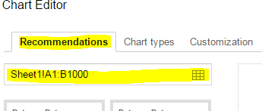
How to expand the selection of cells included in the graph
Access the “Advanced Edit” - “Recommendations” menu to check which cells are included in your graph selection
Click on the small grid to either:
Type in the range of cells/columns to be graphed
Select by highlighting the cells to be graphed
Click “Update” on the Chart Editor menu for the changes to be applied
Back to contents slide

Slide 12
Contents - Troubleshooting
My graph just looks wrong
The line on my graph has a gap
I can’t find the option for inserting a trendline
All of the data is not displaying on the graph
Back to contents slide

Slide 13
My graph just looks wrong
Sometimes the graph will look like several dates are bunched together then the line extends to the other side with more dates bunched together. Sometimes the line will look as if it goes backward across the graph.
This is usually caused by an incorrect date entry. If it’s currently the year 2016 and you type “2/10” then “Enter.” That will be interpreted as 2/10/16. The date will display according to the formatting of the cells. If they are formatted to only display month and day, it may look like 2/10 or Feb-10. It may be necessary to look at the formula bar toward the top of the page to see what year corresponds to the date you entered. The formula bar is under the toolbar and has a “fx” symbol in front of it.
This is important to remember if you are entering data in January from previous months in the school year: You must type in the full date including the year. Otherwise the spreadsheet will default to the current year and your graph will display correctly. Additionally, the trend will not be calculated accurately.
Back to troubleshooting contents

Slide 14
The line on the graph has a gap
If there are dates without data entered, sometimes the line will have a gap. This will not affect the trend but if you don’t like the way it looks follow the steps below.
Option 1: Delete the rows that don’t have data entered. Right click on the row number and select “Delete Row.” If you prefer to leave all school dates in the data entry sheet (helpful to see how attendance might impact performance) but want the graphed line to be connected, use Option 2.
Option 2: On the “Advanced edit” menu, choose “Customization,” scroll down to “Features,” and choose “Plot null values.”
Back to troubleshooting contents

Slide 15
I can’t find the option for inserting a trend line
You must include a date column in your selection of data to be graphed. If there are no dates, the option to add a trendline will not show up in the “Chart Editor” menu. Nor will it be an option if you try to add a trendline after inserting the chart by clicking on the data line.
How to insert a trendline
Back to troubleshooting contents

Slide 16
All of the data is not displaying on the graph
Double check which cells or columns are selected to be included in the graph. You may need to expand the selection of cells included in the graph.
Back to troubleshooting contents

