Slide 1
Welcome
Helping Students Lead Self Determined Lives

Slide 2
Learning Objectives
Participants will have an increased understanding of the connection between Self Determination Skill Sets and Student Outcomes
Participants will be able to identify at least one action step they can take to support Self Determination in their schools.

Slide 3
Self-Determination is a combination of skills, knowledge and beliefs that enable a person to engage in goal directed, self-regulated, autonomous behavior. An understanding of one’s strengths and limitations together with a belief in oneself as capable and effective are essential to self-determination. When acting on the basis of these skills and attitudes, individuals have greater ability to take control of their lives and assume the role of successful adults in our society.
Consensus definition offered by Field, Martin, Miller, Ward, and Wehmeyer (1998)
So, What is Self Determination

Slide 4
Self Control
Self-Determination
Problem Solving
Decision/
Choice Making
Self-Awareness
Self-Advocacy
Self Efficacy
Effective
Communication
Notes:
Here are the skills of Self Determination. They include and are not in any hierarchy: Problem Solving, Effective Communication, Self Advocacy, Self Awareness, Self Efficacy, Decision Making and self control.
The goal of teaching students to be self determined is not to make all students equal in their abilities but rather make the abilities match the student’s life. A student needing to decide to make a choice between a soda and milk for lunch is demonstrating choice making. A student needing to make a decision between which 4 yr college to attend is demonstrating choice making. However, the amount of information needed and the factors to consider are vastly different in these two scenarios. But, both students are demonstrating choice making.

Slide 5
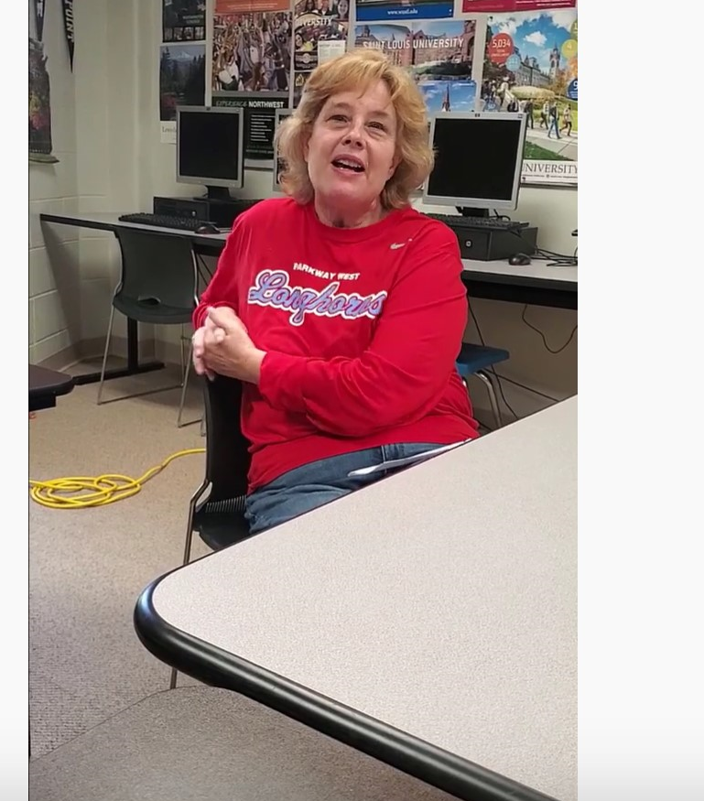
What are the Benefits to Students?

Slide 6
Seems Simple….
So why do so many students lack the skills to get and maintain jobs or attendance a two and four-year college?

Slide 7
What are Those Practices that Might be Hindering Us?

Slide 8
What are Those Mental Models that Might be Continuing Our Lack of Success?

Slide 9
Our Isolation leads
us to Failure
Our strengths and abilities lead us to independence
Our Limitations along with our strengths lead
us to autonomy
Notes:
When you look at our practices with students, there are 3 basic concepts.
The first, and most typical one for students receiving special education services, is the team getting together and makIng decisions in isolation of the student. Think about that. A group of people getting together to make all decisions about what you were going to do for 7.5 hrs of your day and not getting your opinion. Probably will not be so successful. When we isolate students from the conversations about them, we isolate them from learning about their disability, their strengths and their limitations. Without this knowledge, individuals are set up to fail.
Our second model relies on the individual to be able to make decisions and get things done by themselves. To do this, an individual needs to know their strengths and what they can and cannot do, individuals can leverage those strengths to be more independent. From completing simple tasks to more complex tasks and employment-related skills, our strengths lead to independence. Unfortunately, we do not live in a world where all tasks play to our strengths. There are times when a needed task must be done but we have no idea how to accomplish it.
When individuals have the knowledge of their strengths as well as their limitations and have a set of skills to self advocate for their preferences and interests across their strength areas and limitations, their pathway to autonomy is much easier.

Slide 10
98% Of youth with a disability expect to have a paid job
89% of people with disabilities are unemployed or underemployed
66% live in poverty
Approximately 80% of women and 30% Of men with DD have been sexually assaulted--half of these women have been assaulted more than 10 times
Research Says
Students who are expected to work are 5X More likely to have a paid job in the community after high school.
54% are not involved in their community
BJS-Crimes Against Persons with Disabilities (2014)
www.disabilitycompendium.org (2017)
Notes:
A major factor for us when considering the skill sets of self-determination and the use of backward design to teach those skill sets were the outcomes that persons with various disabilities face in the real world.

Slide 11
But the Bottom Line is Always the Bottom Line
Indicator 13
Indicator 14
Indicator 4

Slide 12
If you Want Different Results, You have to Try Different Approaches
OR……
More of the Same Just Gives You More of the Same

Slide 13
Initial group:
61 students in foster care, age 16 and older
12 month intervention program
weekly coaching around self determination skill sets focused on goal setting, student led meetings and transition meetings
Quarterly meetings with a youth mentor who had been in foster care
Research Says
1 year post |  | 2 yr post
Intervention Group | Comparison Group | Intervention Group | Comparison Group
38% Graduated | 26% Graduated | 72% Graduated | 50% Graduated
14% Employed | 19% Employed | 34% Employed | 16% Emloyed

Slide 14
A variable found to increase employment outcomes was having a goal that focused on career development
Research Says

Slide 15
The Big Question: When Do They Do All This?
MAP-A (DLA)
EOCs
Discipline
State Special Days
Curriculum

Slide 16
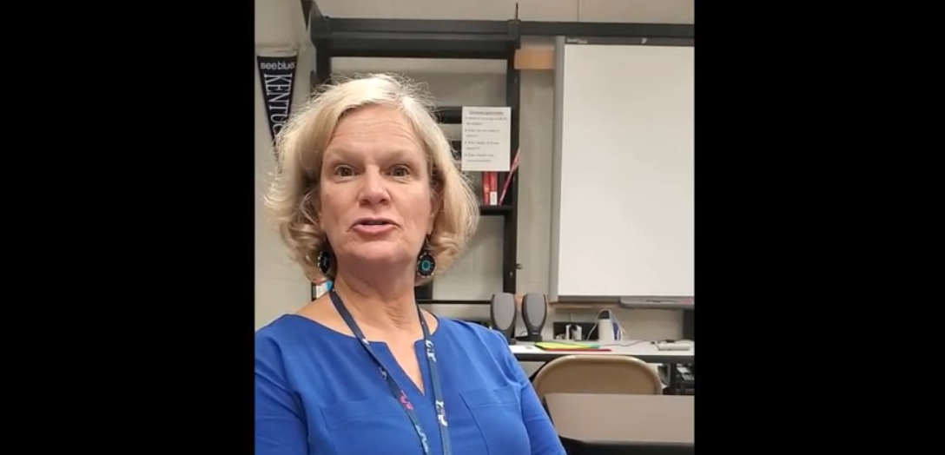
So, Where Do We Begin with Support?

Slide 17
Benefits to the General Education Students

Slide 18
A Suggested Reading
or Book Study

Slide 19
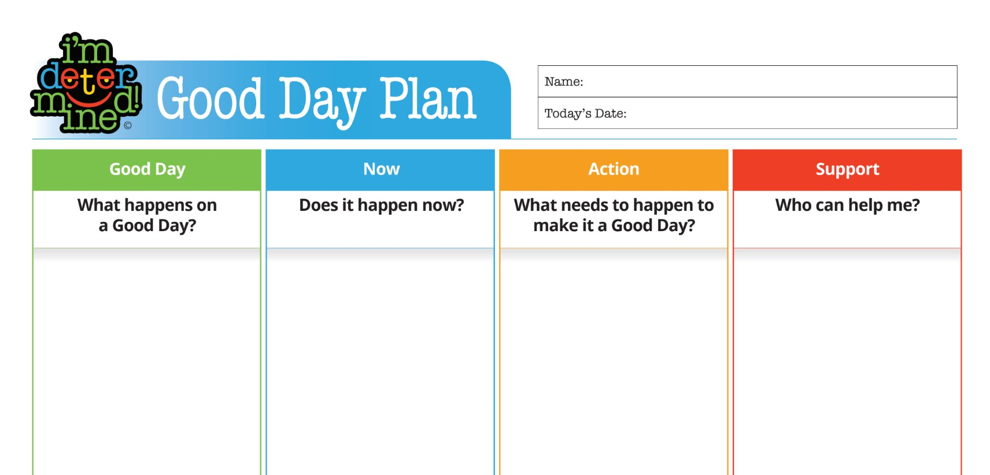

Slide 20
Shoulder Talk
With a Shoulder Partner, identify at least one action step you can take to support self determination in your building?

