Slide 1
SPECIAL EDUCATION FINANCE UPDATES
MOCASE FALL CONFERENCE
SEPTEMBER 2019

Slide 2
TOPICS
Proportionate Share Funding
Coding and Reporting of FY19 Expenditures

Slide 3
PROPORTIONATE SHARE

Slide 4
PROPORTIONATE SHARE
IDEA Part B federal funds that must be reserved and spent to provide special education services to parentally placed private, parochial, and home schooled children with disabilities ages 5-21 who have been evaluated and determined eligible for special education services. Homeschooled children with disabilities between ages 5-7 are also eligible for Proportionate Share services.
The LEA where a private, parochial, or home school is located is responsible for services.
If LEA is required to use federal funds for proportionate share, then must:
Report eligible and served private, parochial, and home schooled children in MOSIS with educational environment code 2100. Eligible children who are not served are reported on the Part B FER Supporting Data page.
Prorate expenditures based on logs/time spent with private, parochial, and home schooled children.
Maintain time and effort documentation for staff paid with federal proportionate share funds.
Track in general ledger by utilizing function code 1224 and/or 2557, source code 4, and project code 44100.

Slide 5
PROPORTIONATE SHARE PROCESS
Child Find
Determine Proportionate Share Amount
Submit Data
December 1
Consultation
Budget Proportionate Share
July 1
Serve
Track and Code
Report Final Costs
September 30
Release Unspent Carryover
Jan 1-March 1

Slide 6
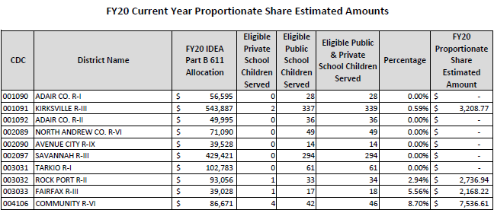
DETERMINE PROPORTIONATE SHARE AMOUNT
How do I know my proportionate share amount?
Special Education Finance calculates an estimated current year amount for each LEA before budget applications open. At least this amount must be budgeted on the initial budget application.
https://dese.mo.gov/financial-admin-services/special-education-finance/part-b-funding-and-allocations

Slide 7
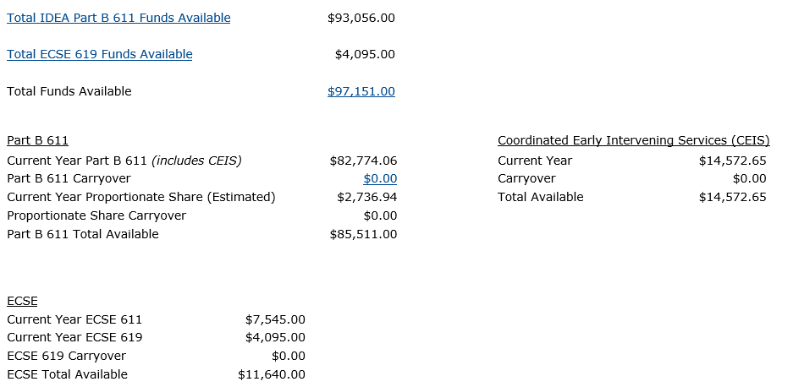
ESTIMATED PROPORTIONATE SHARE AMOUNT
The estimated current year Proportionate Share obligation is shown on the top of the budget grid in ePeGs.

Slide 8
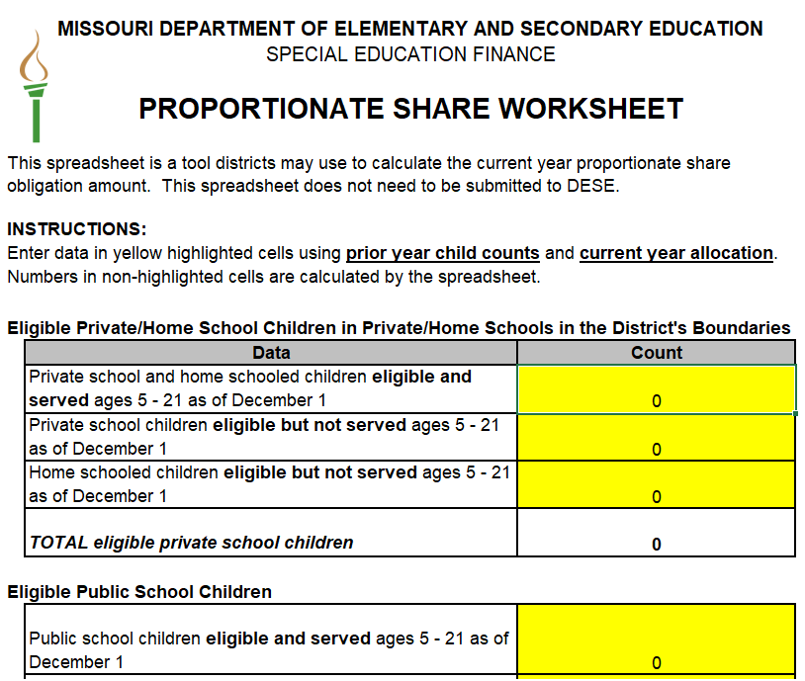
DETERMINE PROPORTIONATE SHARE AMOUNT
How do I know my proportionate share amount?
2. LEAs can calculate a more accurate
current year amount using the
Proportionate Share worksheet.
If this amount is greater than the
estimated amount, the LEA should
budget this amount on the initial budget
application.
https://dese.mo.gov/financial-admin-services/special-education-finance/part-b-proportionate-share

Slide 9
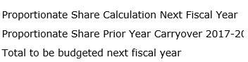
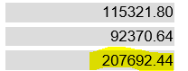
DETERMINE PROPORTIONATE SHARE AMOUNT
How do I know my proportionate share amount?
The final Proportionate Share current year amount and any carryover is calculated on the prior year FER. If the final amount on the FER is different than the current year budgeted amount and/or there is carryover, the LEA must complete a budget revision to budget the “Total to be budgeted next fiscal year” amount from the FER.

Slide 10
DETERMINE PROPORTIONATE SHARE AMOUNT
What data are used to calculate the Proportionate Share amount?
Prior Year:
Private school and home schooled children ages 5-21 eligible and served as of December 1
(Reported in MOSIS/Core Data Screen 11 using the educational environment of “2100-Parentally Placed Private”)
Private school and home schooled children ages 5-21 eligible but not served as of December 1
Public school children ages 5-21 eligible (served and not served) as of December 1
Current Year:
IDEA Part B federal allocation
Percentage of Prop Share Private School Children * IDEA Part B Allocation = Proportionate Share Amount

Slide 11
WILL EVERY LEA HAVE A PROPORTIONATE SHARE AMOUNT?
  No. The Proportionate Share obligation is zero for the next school year if:
  There are no Proportionate Share carryover funds from the prior year.
  There are no students found eligible through the child find process in the current year.
  The LEA receives transfer students or identifies new students through evaluations after the eligible count is taken in December.

Slide 12
SPENDING PROPORTIONATE SHARE FUNDS
What are allowable Proportionate Share costs?
Proportionate Share funds can be used in the following ways:
  Distributed for services identified in students’ service plans who attend private/parochial/home schools
  Have LEA employed staff or contractors provide services or training at the public school or at a neutral site for private school staff who work with students with disabilities
  Provide transportation for students to receive Proportionate Share services
What are unallowable Proportionate Share costs?
Proportionate Share funds cannot be used in the following ways:
  Pay for child find costs
  Paid directly to the private, parochial, or home school
  Utilizing services, equipment, and personnel onsite at a student’s private school UNLESS considered neutral site

Slide 13
SPENDING PROPORTIONATE SHARE FUNDS
What if the costs of services exceed the Proportionate Share funds?
Once the LEA has spent the entire amount (current year and carryover, if any) of Proportionate Share funds, the LEA has met its obligation.
Can the LEA spend more than the Proportionate Share amount?
IDEA PART B FEDERAL FUNDS: Yes, as long as the LEA meets all the other requirements of the Act, including providing a Free Appropriate Public Education (FAPE) to public school children with disabilities.
STATE/LOCAL/COUNTY: Yes, but only to supplement, and not supplant, the Proportionate Share of federal funds required. This means that the LEA must spend ALL federal Proportionate Share funds prior to utilizing state, local, or county funds. Additional state, local, or county expenditures must be included in the MOE calculation.

Slide 14
TRACKING PROPORTIONATE SHARE EXPENDITURES
Code Proportionate Share Services to 1224
Public LEA employee salary and benefits
  Employees providing services must not be included in SDAC cost pool for the portion of the time they are coded as Proportionate Share
Professional development provided to private school staff
Equipment used for delivering services to students
Code Proportionate Share Transportation to 2557
Costs incurred to transport students from private school to neutral site where services are provided
Transportation to and from students’ homes is not a proportionate share cost
If paid with IDEA Part B federal funds must track with 44100 project code; If paid with state, local, or county funds must track with 12210 project code.

Slide 15
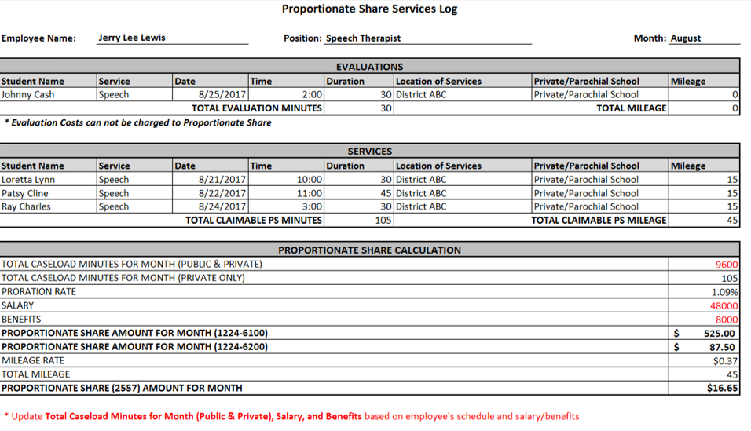
TRACKING PROPORTIONATE SHARE EXPENDITURES

Slide 16
TRACKING PROPORTIONATE SHARE EXPENDITURES
If the LEA does not spend all of the current year Proportionate Share obligation, the remaining current year amount MUST be reserved and allowed to carry over to the next year.
Example:
2019-20 Total IDEA Part B 611 federal funds available = $100,000
2019-20 Current Year Proportionate Share amount = $5,000
2019-20 Proportionate Share amount spent = $4,000
*The total amount of IDEA Part B 611 federal funds the LEA is allowed to spend in 2019-20 is $99,000. $1,000 of remaining unspent current year proportionate share funds MUST be allowed to carry over into 2020-21.

Slide 17
RELEASING UNSPENT PROPORTIONATE SHARE CARRYOVER FUNDS
LEAs have two years to spend proportionate share funds. Any current year funds NOT spent in the first year must carry over to the next year. These become carryover funds in the next year.
Carryover funds must be spent in the second year. If the LEA cannot spend the carryover funds in full, the remaining unspent carryover funds can be released or forfeited. Released proportionate share carryover funds can be spent on public school students with disabilities. Forfeited funds are lost.

Slide 18
Example 1: Released Funds
Carryover Amount (from previous year) | $50,000
Current Year Obligation (from current year) | $70,000
Total Available for Proportionate Share | $120,000
Estimated Expenditures for Current Year | $40,000
Amount Available for Release | $10,000

Slide 19
Example 2: NO Released Funds
Carryover Amount (from previous year) | $50,000
Current Year Obligation (from current year) | $70,000
Total Available for Proportionate Share | $120,000
Estimated Expenditures for Current Year | $60,000
Amount Available for Release | $0

Slide 20
ALLOWABLE REASONS FOR UNEXPENDED CARRYOVER FUNDS
Student(s) no longer attends private/parochial school or home school within LEA boundaries
Student(s) aged-out/graduated from private/parochial school or home school
Private/parochial school(s) refused services
Parents refused services
Proportionate Share Carryover funds exceeded the amount needed for services provided
Other (must describe)

Slide 21
CODING AND REPORTING OF
FY19 EXPENDITURES

Slide 22
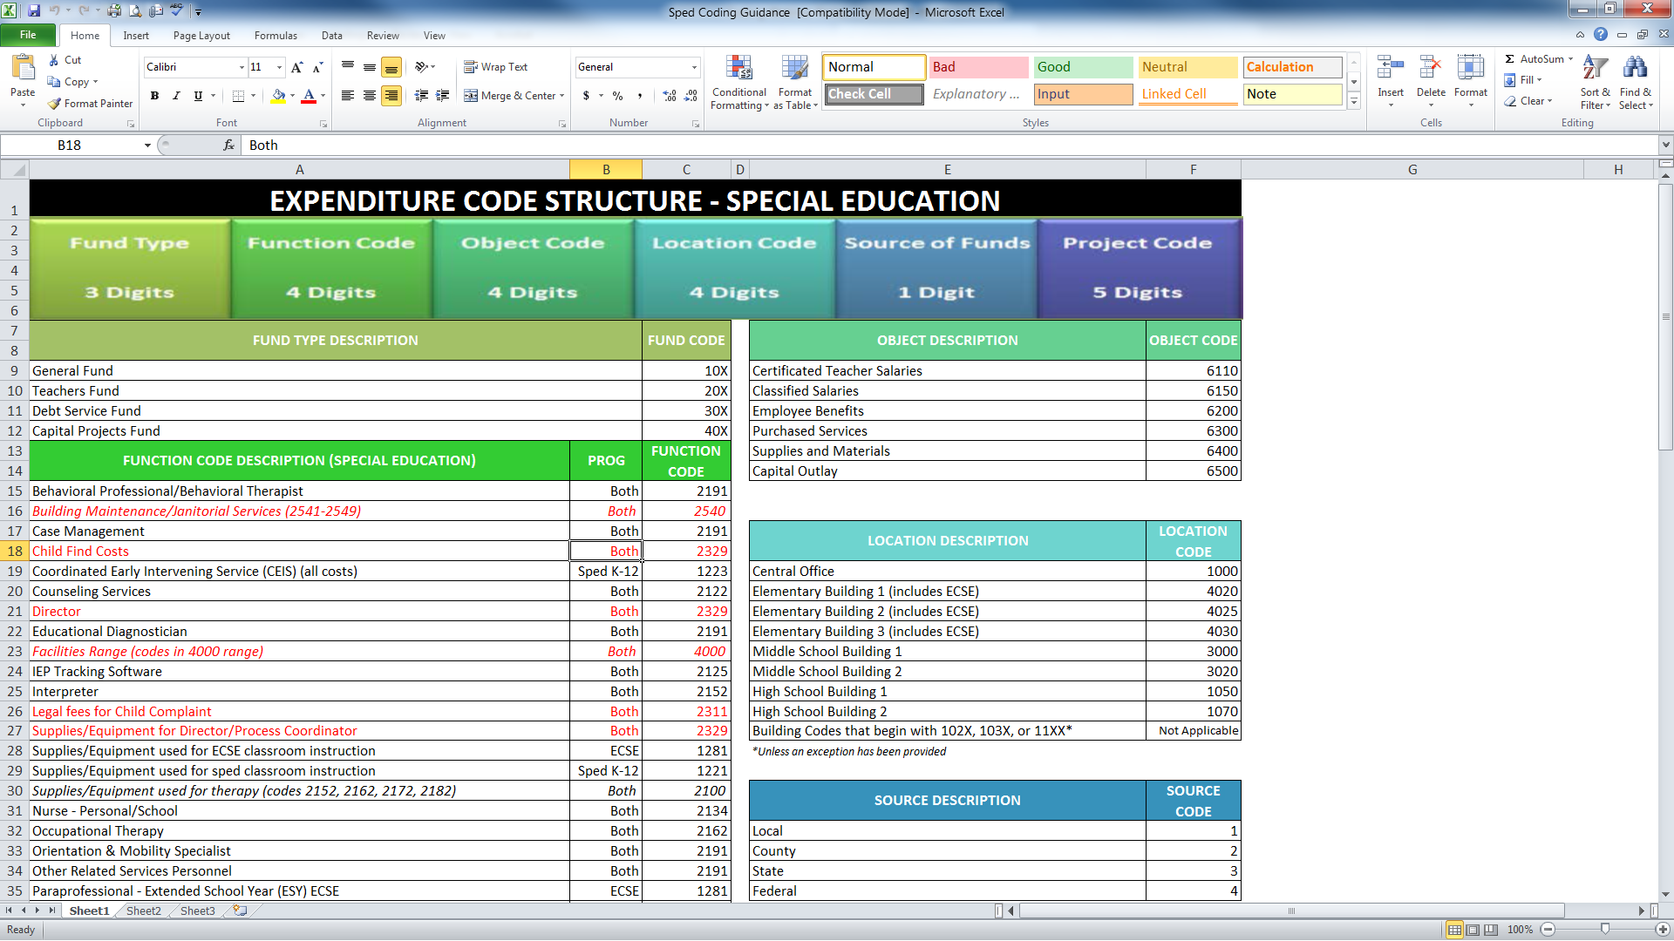
ACCOUNTING CODE STRUCTURE
The Source of Funds Code is used to identify a subset of revenue used to fund a specific expenditure.
The Project Code is used to identify an expenditure paid for with a specific source of revenue or part of a specific grant.

Slide 23
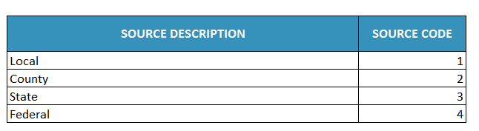
SOURCE OF FUNDS
SOURCE CODE
1 Digit

Slide 24
SPECIAL EDUCATION PROJECT CODES
Project Description – State/Local/County Funding | Project Code
K-12 Special Education Expenditure | 12210
ECSE Expenditure | 12810
Project Description – Federal Funding | Project Code
IDEA Part B (611) Entitlement Regular Part B, Proportionate Share, and CEIS | 44100
ECSE 611 | 44200
ECSE 619 | 44201

Slide 25
PART B FER

Slide 26
ASBR Expenditures July 1 to June 30
Special Education Part B FER Grid
Source Code | Project Code | Expenditures | Pull Onto | Display
4 | 44100 | K-12 public special education, proportionate share, and CEIS costs paid with Federal IDEA Part B 611 funds | Part B FER Grid | Amounts by Function, Object, Project
4 | 44200 | ECSE costs paid with Federal IDEA ECSE 611 funds | Part B FER ECSE 611 Row | Cumulative by Object, Project
4 | 44201 | ECSE costs paid with Federal IDEA ECSE 619 funds | Part B FER ECSE 619 Row | Cumulative by Object, Project

Slide 27
ASBR Expenditures July 1 to June 30
Special Education Part B FER
MOE STATE GRID
Source Code | Project Code | Expenditures | Pull Onto | Display
3 | 12210 | K-12 special education costs paid with state funds | MOE State Grid | Amounts by Function, Object, Project
3 | 12810 | ECSE costs paid with state funds | MOE State Grid | Amounts by Function, Object, Project

Slide 28
ASBR Expenditures July 1 to June 30
Special Education Part B FER
MOE COUNTY GRID
Source Code | Project Code | Expenditures | Pull Onto | Display
2 | 12210 | K-12 special education costs paid with county funds | MOE County Grid | Amounts by Function, Object, Project
2 | 12810 | ECSE costs paid with county funds | MOE County Grid | Amounts by Function, Object, Project

Slide 29
ASBR Expenditures July 1 to June 30
Special Education Part B FER
MOE LOCAL GRID
Source Code | Project Code | Expenditures | Pull Onto | Display
1 | 12210 | K-12 special education costs paid with local funds | MOE Local Grid | Amounts by Function, Object, Project
1 | 12810 | ECSE costs paid with local funds | MOE Local Grid | Amounts by Function, Object, Project

Slide 30
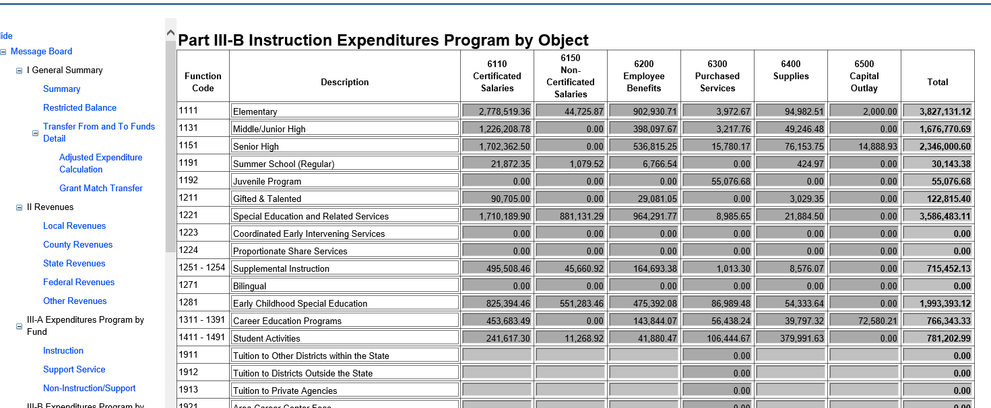

Slide 31
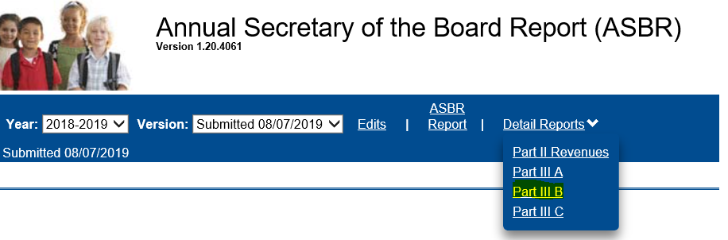
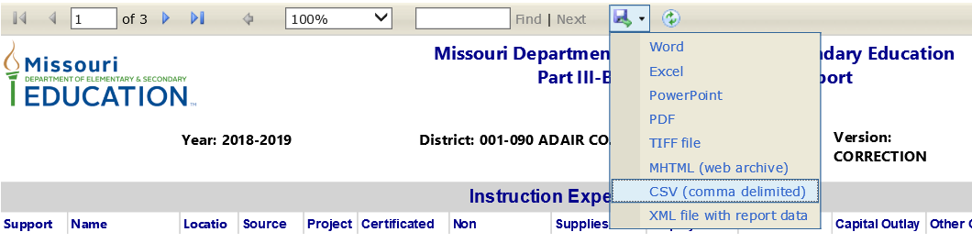

Slide 32
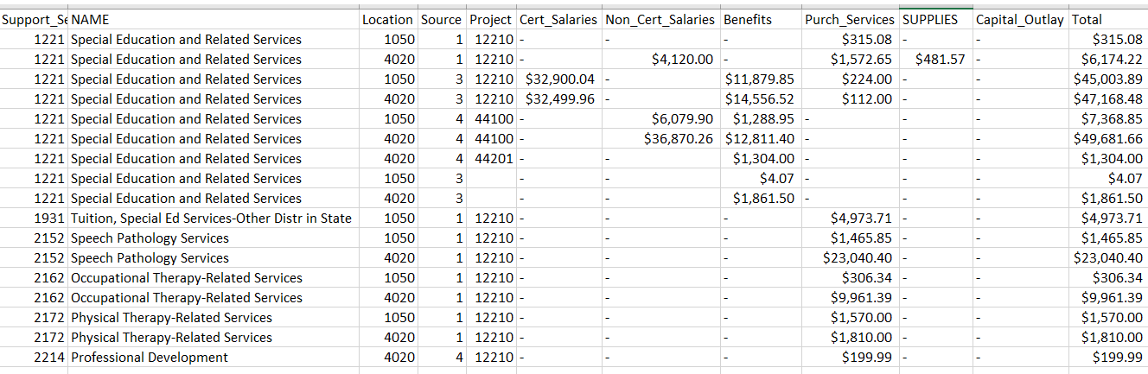

Slide 33
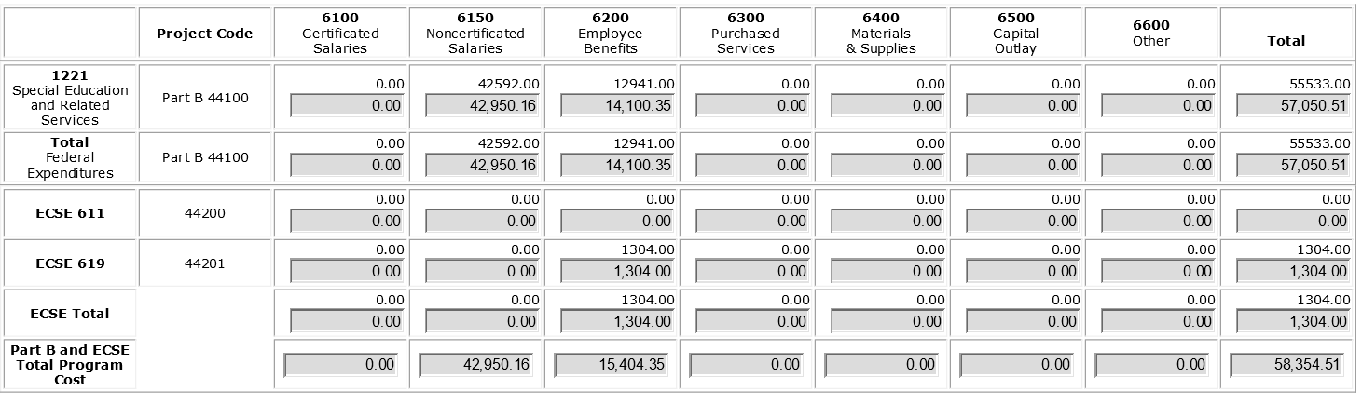
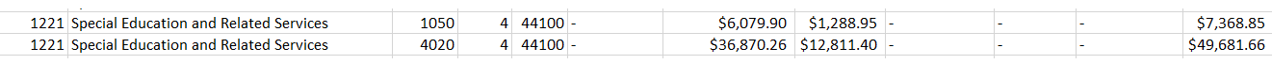
2018-2019 FER Grid – IDEA Part B Federal Entitlement

Slide 34
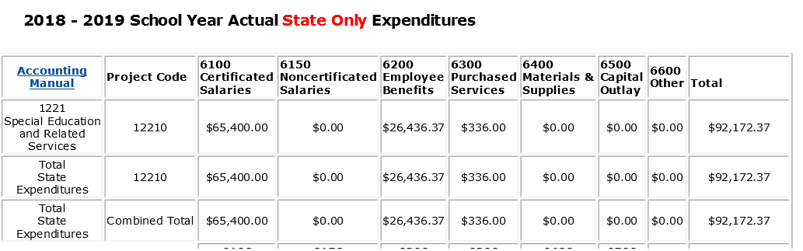
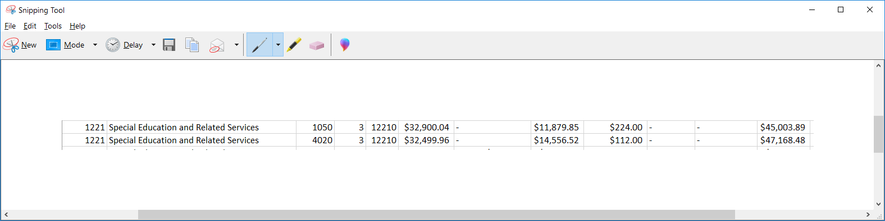

Slide 35
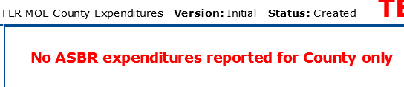

Slide 36
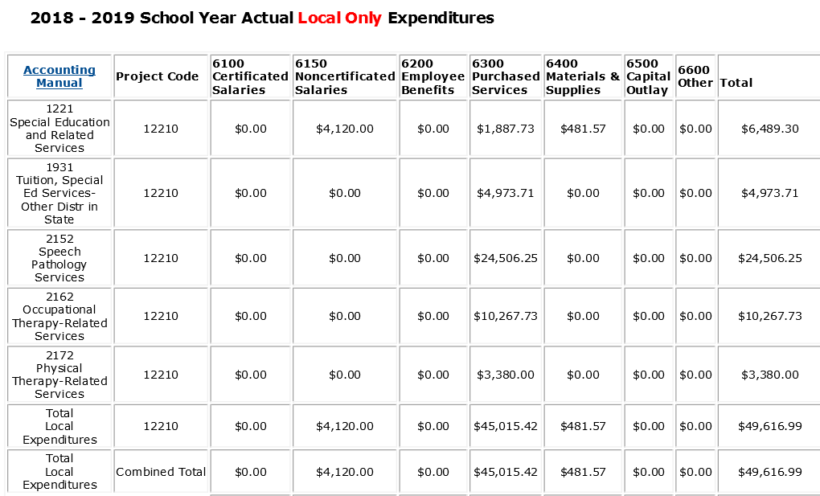
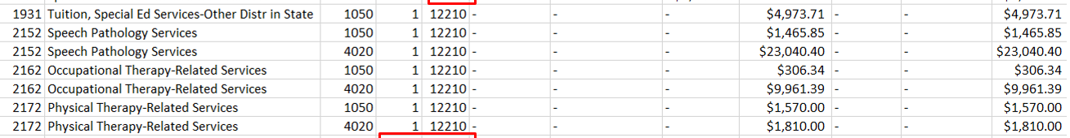

Slide 37
MOE COMPLIANCE DETERMINATION

Slide 38
MOE COMPLIANCE REQUIREMENT
WHAT
To show the LEA has maintained the amount of state, local, and/or county (non-federal) it spent for the special education program
Non-federal funds spent in Current Year ≥ Expended Last FY Met MOE Compliance
SIGNIFICANCE
Failure requires the LEA to pay back state, local and/or county funds

Slide 39
METHODS FOR MEETING MOE
LEAs must meet MOE by one of the following methods:
Total Local Funds (Including County) Only
Per Child Local Funds (Including County) Only
Total Combination of State and Local (Including County) Funds
Per Child Combination of State and Local (Including County) Funds
LEAs can change the method used to meet MOE from year to year.

Slide 40
CODING SPECIAL EDUCATION COSTS FOR MOE
Source Code 1
Project Codes 12210 & 12810
Source Code 2
Project Codes 12210 & 12810
MOE Local Only

Slide 41
CODING SPECIAL EDUCATION COSTS FOR MOE
Source Code 1
Project Codes 12210 & 12810
Source Code 2
Project Codes 12210 & 12810
Source Code 3
Project Codes 12210 & 12810
MOE State and Local

Slide 42
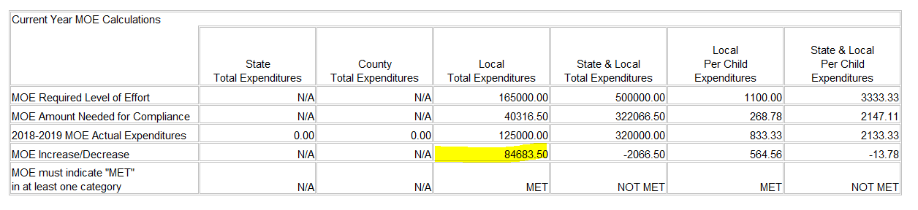
MOE RED FLAGS – LARGE INCREASE TO LOCAL

Slide 43
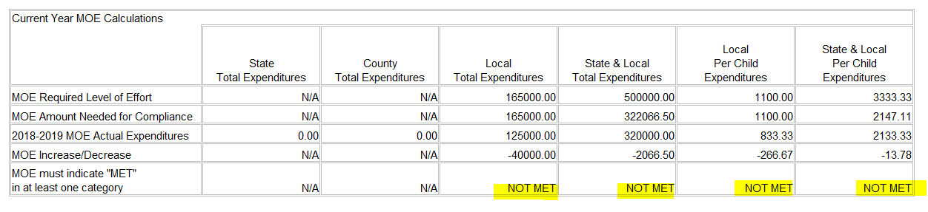
MOE RED FLAGS – LARGE LOCAL DECREASE & NOT MET IN ANY METHOD

Slide 44
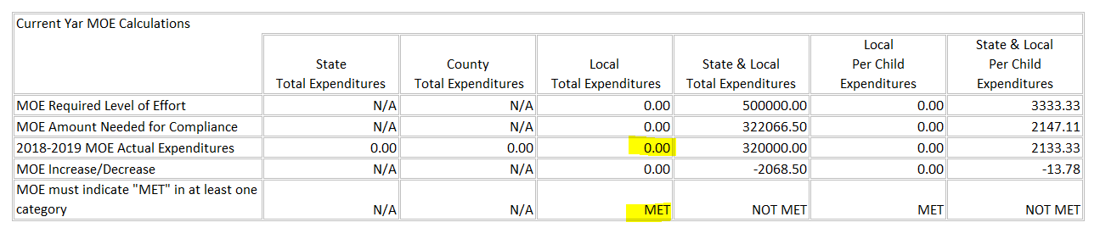
MOE RED FLAGS – ONLY MEETING ON ZERO LOCAL

Slide 45
ECSE FER

Slide 46
ASBR Expenditures July 1 to June 30
Early Childhood Special Education (ECSE) FER Grid
Source Code | Project Code | Expenditures | Pull Onto | Display
1, 2, 3 | 12810 | ECSE costs paid with local, county, and state funds | ECSE FER Grid | Amounts by Function, Object, Project
4 | 44200 | ECSE costs paid with Federal IDEA ECSE 611 funds | ECSE FER Grid | Amounts by Function, Object, Project
4 | 44201 | ECSE costs paid with Federal IDEA ECSE 619 funds | ECSE FER Grid | Amounts by Function, Object, Project

Slide 47
FER FEDERAL ADJUSTMENTS

Slide 48
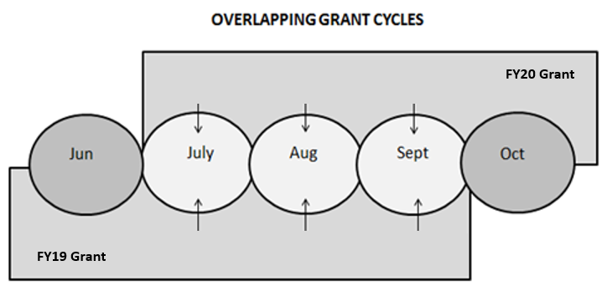
OVERLAPPING GRANT CYCLES
LEAs have 3 extra months (July, August, September) from the end of the fiscal year to continue to code expenditures and request funds for obligations made by June 30
This creates overlapping grant cycles where the LEA is coding expenditures for 2 fiscal years of grants simultaneously in the same general ledger
NEW YEAR GRANT
PRIOR YEAR GRANT

Slide 49
GRANT FY | FIRST DAY TO OBLIGATE FUNDS | LAST DAY TO OBLIGTE FUNDS | LAST DAY TO LIQUIDATE FUNDS
FY19 | July 1, 2018 | June 30, 2019 | September 30, 2019
FY20 | July 1, 2019 | June 30, 2020 | September 30, 2020
July, 2019
August, 2019
September, 2019
Can spend FY19 funds that were obligated by June 30, 2019
Can spend FY20 funds for obligations after July 1, 2019
Can spend FY19 funds that were obligated by June 30, 2019
Can spend FY20 funds for obligations after July 1, 2019
Can spend FY19 funds that were obligated by June 30, 2019
Can spend FY20 funds for obligations after July 1, 2019

Slide 50
TRACKING GRANT FY COSTS SEPARATELY
If prior year federal grant funds are used to pay for a prior year cost in July, August, or September, the cost MUST be tracked separately in the new year general ledger.
Funds from a new grant (FY20) cannot be used for obligations that occurred in the previous grant (FY19).
Federal Funds Used | Obligation Year | Costs | Date Paid | FER Year Costs Reported | General Ledger and ASBR Year Cost Reported | Source Code | Project Code
Prior Year IDEA Entitlement Funds, Part B 611 IDEA | FY19 | K-12 public special education, prop share, and CEIS costs | July, Aug or Sept 2019 | FY19 | FY20 | 4 | 44199
Prior Year IDEA – ECSE 611 | FY19 | ECSE costs | July, Aug or Sept 2019 | FY19 | FY20 | 4 | 44299
Prior Year IDEA – ECSE 619 | FY19 | ECSE costs | July, Aug or Sept 2019 | FY19 | FY20 | 4 | 44298

Slide 51
TRACKING GRANT FY COSTS SEPARATELY
IDEA Part B federal project code indicates which grant funds are paying the expenditure
(44100=FY20, 44199=FY19)

Slide 52
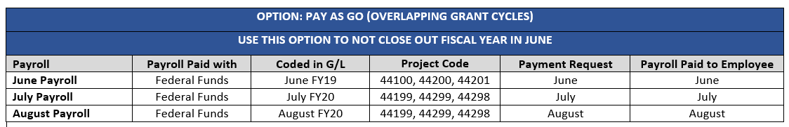
SUMMER PAYROLL
June Payroll = FY19 General Ledger (coded as current year expenditure)
July Payroll = FY20 General Ledger (coded as prior year expenditure)
August Payroll = FY20 General Ledger (coded as prior year expenditure)

Slide 53
FUNDING OPTIONS
Use prior year (FY19) grant funds to pay (because cost was obligated by June 30)
OR, can use state funds to pay
OR, can use local funds to pay
OR, can use county funds to pay

Slide 54
EXPENDITURES PULLED ONTO FY19 FERs
ASBR (All Expenditures)
July 1, 2018 June 30, 2019
ECSE FER and Part B FER MOE (Nonfederal Expenditures)
July 1, 2018 June 30, 2019 *No adjustments needed
ECSE and Part B FER - Federal
July 1, 2018 s June 30, 2019
July, August, September , 2018 July, August, September, 2019
*Negative adjustment needed for costs paid with FY18 Federal funds
*Positive adjustment needed for costs paid with FY19 Federal funds
Do NOT include costs paid with FY20 Federal funds

Slide 55
RESOURCES
Special Education Finance Due Dates / Payment Request Deadlines
https://dese.mo.gov/financial-admin-services/special-education-finance/special-education-finance-due-dates
Fiscal Monitoring Guide
https://dese.mo.gov/financial-admin-services/special-education-finance/fiscal-monitoring
ePeGs Guides
https://dese.mo.gov/financial-admin-services/special-education-finance/special-education-finance-resources
Time and Effort
https://dese.mo.gov/financial-admin-services/special-education-finance/fiscal-monitoring
Proportionate Share
https://dese.mo.gov/financial-admin-services/special-education-finance/part-b-proportionate-share

Slide 56
SPECIAL EDUCATION FINANCE CONTACTS
Name | Title
Angie Nickell | Director, Special Education Finance (573) 751-4385 Angie.Nickell@dese.mo.gov
Leslie Turpin | Assistant Director, Special Education Finance (573) 751-7022 Leslie.Turpin@dese.mo.gov
Ellen Bohrn | Data Specialist, Special Education Finance (573) 751-0623 Ellen.Bohrn@dese.mo.gov
Betty Lohmann | Program Specialist, Special Education Finance (573) 751-6904 Betty.Lohmann@dese.mo.gov

