Slide 1

Missouri Council of Administrators of Special Education
2019 Fall Conference
Monday, September 23, 2019
Tan-Tar-A Resort, Lake of the Ozarks

Slide 2


Welcome!!!
Safe and Civil Schools
Leadership Project

Slide 3







The Safe and Civil Schools Leadership Project
Supporting school leadership in the development and maintenance of positive school climate, safety and connectedness.
College of Education

Slide 4



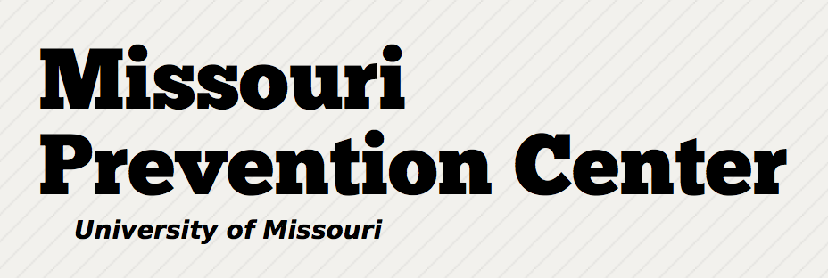

Partners in this project include:
Notes:
Insititue of Education Sciences is a branch of the US Dept of Education

Slide 5
What is…
Safe and Civil Schools Leadership Project?
Dr. Randy Sprick
SCSLP supports school leaders…
Create effective school environments
Develop leadership teams with hands-on-training
Promote effective disciplinary structures
Develop/Implement student support systems
Focus on school safety (rules, regulations, policies, procedures)
Promote positive student behaviors

Slide 6
What is…
Safe and Civil Schools Leadership Project
Dr. Randy Sprick
Focus on school-wide academic/discipline improvement (common areas, classroom, individual students)
Improve school culture/climate (proactive, positive, instructional approach)
Develop viable SBP/SIP
Analyze and effectively use data in school-wide decision making
Develop a school-wide philosophy of continued school improvement

Slide 7
Traits of Effective Leaders…
(Activity #1)
Manage space and materials efficiently.
Communicate expectations clearly.
Provide positive feedback.
Be genuine and honest.
Empathize w/others (listening for understanding).
Treat everyone with respect.

Slide 8
Traits of Effective Leaders…
Be highly visible.
Respect confidentiality.
Treat all staff professionally.
Make a special effort to include noncertified staff.
Acknowledge past efforts before you suggest change.
Build trust with parents and community members.

Slide 9
Leadership Responsibilities activity #2
(average correlation w/student academic achievement) Marzano, Waters & McNulty, 2005
Affirmation
Change Agent
Contingent Rewards
Communication
Culture
Discipline
Flexibility
Focus
Ideals/Beliefs
Input
Intellectual Stimulation
Involvement in Curr/Instr/Assess
Knowledge of Curr/Instr/Assess
Monitoring/Evaluation
Optimizer
Order
Outreach
Relationships
Resources
Situational Awareness
Visibility

Slide 10
Leadership Responsibilities
(average correlation w/student academic achievement) Marzano, Waters & McNulty, 2005
Affirmation (.19)
Change Agent (.25)
Contingent Rewards (.24)
Communication (.23)
Culture (.25)
Discipline (.27)
Flexibility (.28)
Focus (.24)
Ideals/Beliefs (.22)
Input (.25)
Intellectual Stimulation (.24)
Involvement in Curr/Instr/Assess (.20)
Knowledge of Curr/Instr/Assess (.25)
Monitoring/Evaluation (.27)
Optimizer (.20)
Order (.25)
Outreach (.27)
Relationships (.18)
Resources (.25)
Situational Awareness (.33)
Visibility (.20)

Slide 11

Distributed/Shared Leadership
Activity #3
Define…

Slide 12
Distributed/Shared Leadership
Leadership that includes teams of staff members is not a new concept.
Defined as a leadership style in which school governance is distributed among several staff members from different areas of the school community for the purpose of:
  Decision making
  Evaluation
  Policy development/revision
  Overall school improvement

Slide 13
Distributed/Shared Leadership
Activity #4
What are some advantages of a leader sharing leadership responsibilities with colleagues?
What are some challenges a leader faces when sharing leadership responsibilities with colleagues?
What are some ways you share leadership responsibilities with your colleagues?

Slide 14
Potential Advantages of Shared Leadership
Leaders relieved of some managerial duties in order to pay attention to other priorities
Increased understanding by colleagues leads to greater support and empathy for the leader’s role
Investment of staff in decision making leads to engagement
Development of skills (some will become leaders!)
Expansion of talents, expertise, experience and perspectives

Slide 15
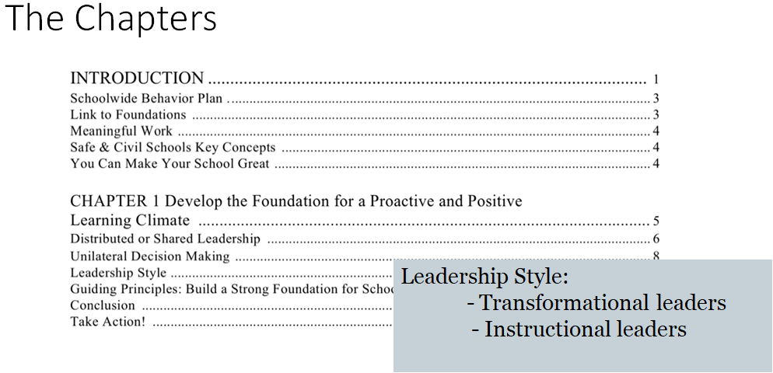
Leadership In Behavior Support

Slide 16
What’s Your Leadership Style?
Activity #5
Based on your current understanding of these two leadership styles, which one do you tend towards?
  Transformational Leader
  Instructional Leader

Slide 17
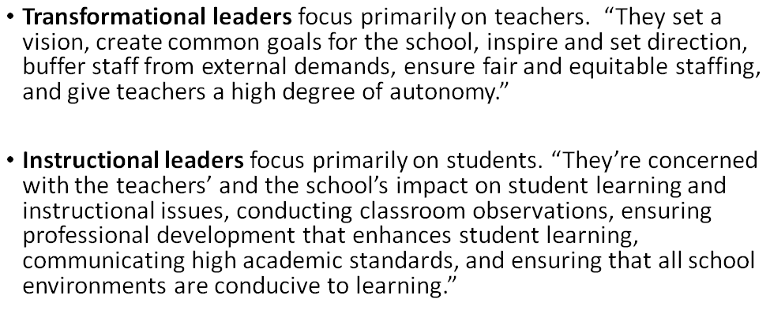
Leadership Styles
Hattie 2015

Slide 18
Leadership Styles
Hattie 2015
Transformational leaders average effect size on student outcomes was 0.11
Instructional leaders average effect size on student outcomes was 0.42
-Robinson, Loyd, Rowe (2008)

Slide 19
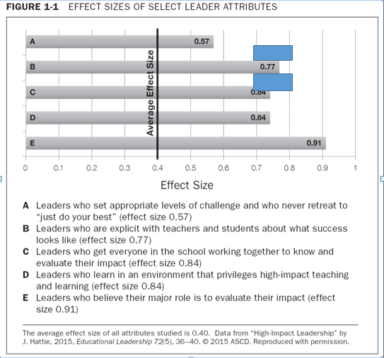
Self-Reflection: How does my leadership style reflect these attributes? Activity #6

Slide 20
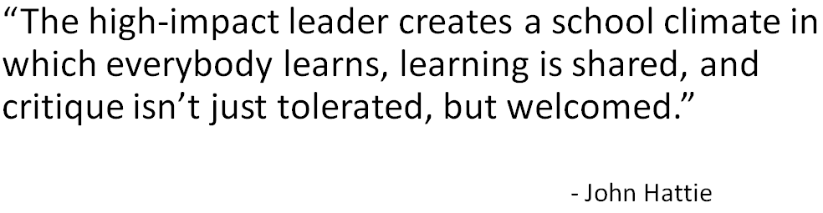

Slide 21


Slide 22
Safe and Civil Schools’ Philosophy and Beliefs
All students must be treated with respect.
Behavior can change. (ABC Model of Behavioral Theory)
Students should be taught the skills and behavior needed for success. (common language, expectations, guidelines for success)
Motivation and responsibility should be encouraged through positive interaction and building relationships with students.
Student misbehavior provides a teaching opportunity. (common language, expectations, guidelines for success)
Collaboration is critical. All staff members must work together to help students behave respectively and to meet student needs.

Slide 23
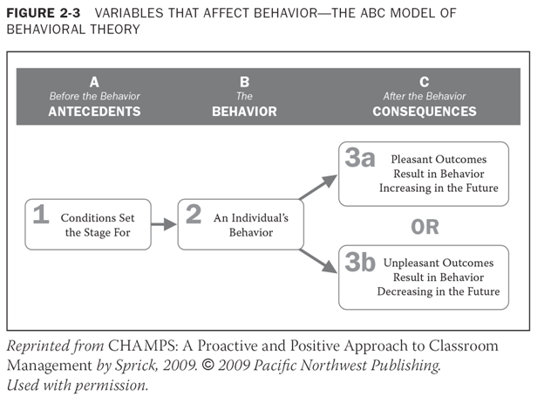
Understanding Behavioral Theory

Slide 24
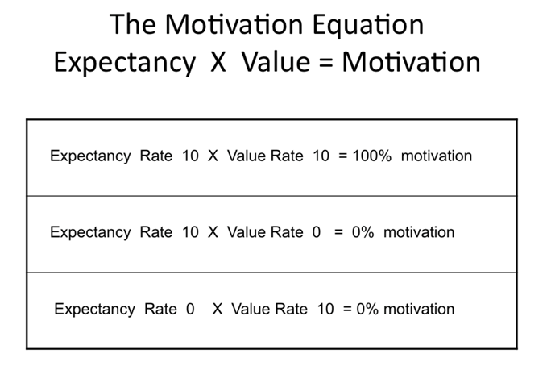
Understanding Behavioral Theory
Activity #7

Slide 25
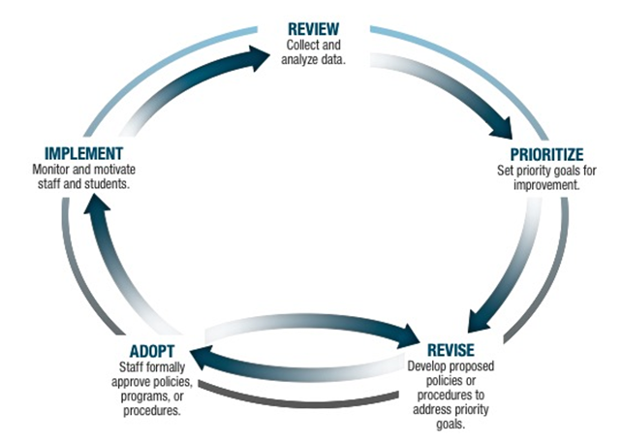
The Continuous Improvement Cycle

Slide 26


Slide 27
STOIC Framework
Activity #8
Structure: Structure all school settings for success
Teach: Teach behavioral expectations to students for all common areas and the classroom.
Observe: Observe and monitor student behavior (Supervise)
Interact: Interact positively with students
Correct: Correct fluently, respectfully and immediately

Slide 28
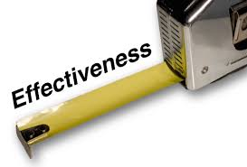
How is effectiveness measured?
Principal perception surveys
  Self-perceived leadership skills
  School climate; teacher and student behaviors
Teacher anonymous surveys
  Brief perception survey
  School organization, student behaviors
Student anonymous surveys
  Brief perception survey
  Bulling, victimization, school climate
Building observations
  Common area walk-through observations conducted by Research staff, blind to study condition, twice per year to record frequency of behaviors

Slide 29
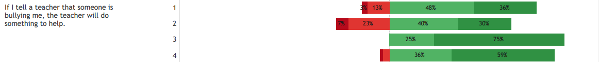
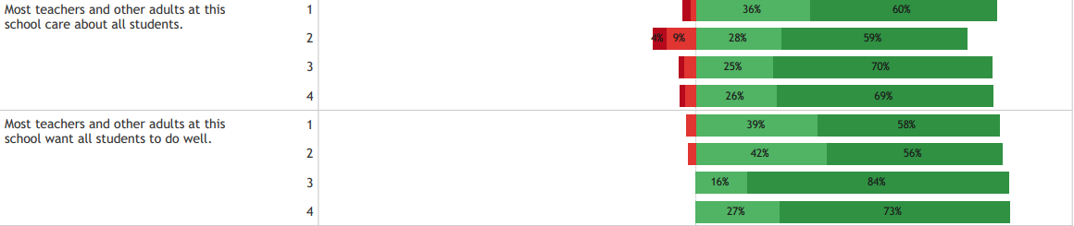
Sample Student Survey
Fall 2017
Spring 2018
Fall 2018
Spring 2019

Slide 30

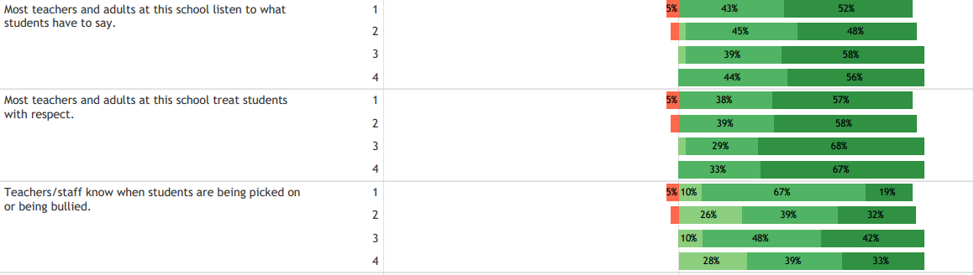
Sample Staff Survey
Fall 2017
Spring 2018
Fall 2018
Spring 2019

Slide 31
Data Analysis
Team/Table Activity #9
Fall 2017
Spring 2018
Fall 2018
Spring 2019
Using the Continuous Improvement Cycle analyze the Student Support Survey Data Results and work through the process.

Slide 32

Student/Staff Survey “other” Measureable Scales
Respect
Student Engagement-Affective
Academic Expectations
Rules and Behavioral Expectations
School Safety and Risk
Victim Experiences
Teasing/Bullying
Physical Altercations/Threats

Slide 33
SCSLP Support not Replacement
SCSLP works in conjunction with school improvement initiatives and does not replace existing programs.
PBIS (Positive Behavioral Interventions and Supports)
LIMS (Leader in Me School)
BIST (Behavior Intervention Support Team)
AVID (Advancement Via Individual Determination)
RtI (Response to Intervention)

Slide 34
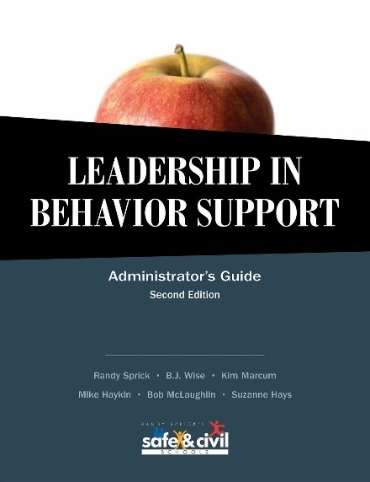
Leadership and Coaching Programs
The program is for principals and school behavior support teams and focuses on:
  Strengthening school behavior support leadership teams
  Promoting student pro-social behaviors and achievement
  Reducing bullying, victimization, and tardiness, and
  Using data effectively.

Slide 35

Training and Support
One full-day workshop for principals and leadership teams (Wednesday, Nov 6, 2019)
Conducted by Safe & Civil Schools Leadership Trainer and supervised by Dr. Randy Sprick
  Funds to support time and meals are provided
Ongoing Coaching
  Provided on-site throughout the year
Online Training Resources and Webinars
  Using web-based systems
Books & Intervention Materials
  Provided to each principal in the treatment group
Booster Training Session

Slide 36

Additional supports include:
Schools receive $500 stipend each year of participation in the project.
Principals and leadership teams receive training, coaching, and supplemental materials.
Regional personnel will be paid for Train the Trainer at end of project to support sustainability.
On-line training and webinars.

Slide 37
How are schools selected for training?
Principals provide consent forms.
Participating schools will be randomly assigned to one of two groups (Treatment/Control) by a statistician.
Half of the schools (Treatment) will receive the training in years one and two.
At the end of year two, (Control) will receive the same training, materials and supports.

Slide 38

Benefits of participating include:
Principal/Teacher Benefits
Student Benefits
  Increased use of effective positive school climate skills.
  Improved school organizational health.
Feeling less stressed and more effective at handling challenging behaviors.
Students from schools of principals trained in the program have been shown to be:
  Less aggressive with peers
  More cooperative with teachers
  Exhibit higher on-task and
  pro-social behaviors
  Reduced tardiness and greater time on task

Slide 39

Next Steps
Identify participating schools
Principals complete a participation consent form
Conduct on-line surveys in Sept/Oct, 2019 (principals, students and staff)
Plan for Nov. 6th training and regular webinars.

Slide 40
Safe & Civil Schools
Leadership Project (SCSLP) Team
Program Directors
  Keith Herman, Ph.D.
    School psychologist
  James Sebastian, Ph.D.
    Education leadership
  Wendy Reinke, Ph.D.
    School psychologist
Co-investigators
  Aaron Thompson, Ph.D.
    Social work; former principal
  Francis Huang, Ph.D.
    Statistician
Program Coach and on-site Coordinator
  Dennis J. Walker, Ph.D.
Program Assessment Team
  Marcus Petree
  Lauren Henry
  Colleen Eddy
Contacts:
Keith Herman, Ph.D. Dennis J. Walker, Ph.D.
hermanke@missouri.edu walkerdj@missouri.edu
573-355-1140 816-808-0357

Slide 41

History of Missouri Prevention Center
University of Missouri research team has partnered with school districts throughout the country on many successful grant projects
    Nearly $25 million of funding for schools since 2010
Projects have delivered high quality services to hundreds of teachers and thousands of students:
    CHAMPS: An evaluation of a middle school classroom mgmt program
    Incredible Years: An evaluation of a elementary classroom mgmt program
    STARS: A self-monitoring intervention for youth with disruptive behaviors
    Classroom Check Up: Developing an online teacher development program
    School Mental Health: County-wide student mental health screening and support
New grants focus on principal training and support

Slide 42

Questions or comments?

Slide 43
School Leadership
Handling The Special Challenges of School Leadership
Develop a plan for handling disagreements
Deal with difficult situations
Ensure safety
Analyze data/Develop appropriate policies and procedures (attendance, tardies, discipline, bullying, office referrals)
Improve school culture/climate

Slide 44
Special Challenges of School Leadership
Engage staff members who are reluctant to change/buy-in
Leadership From A Dancing Guy

